Slide 1
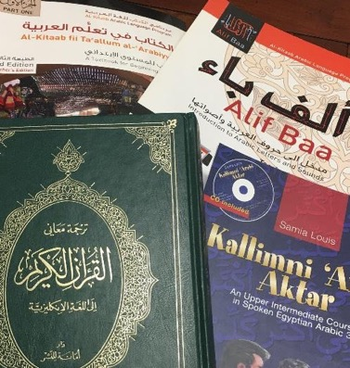
Good reasons to study Arabic
Center for Arab &
Islamic Studies
St. Bonaventure University
www.sbu.edu/CAIS

Slide 2
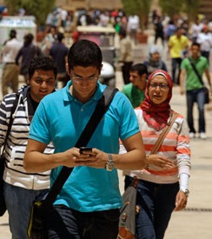
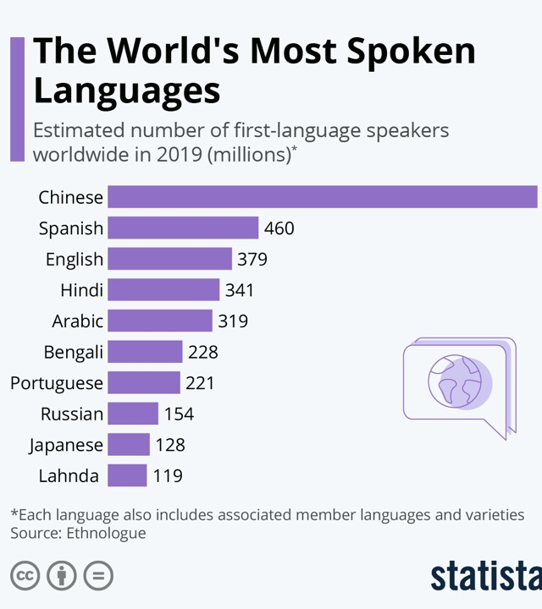
Arabic is ranked 5th in the number of native speakers worldwide:

Slide 3
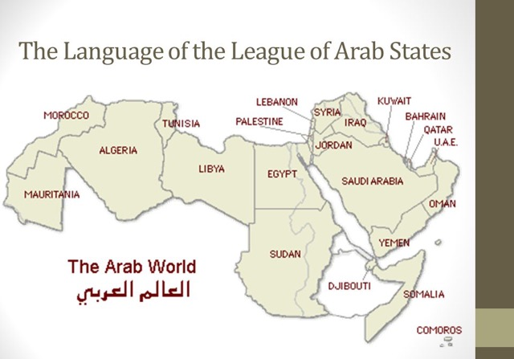
It is the official language of 22 countries in Africa and the Middle East

Slide 4
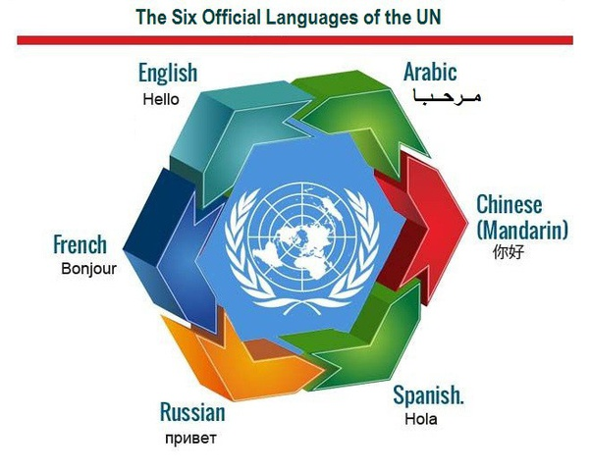
It is one of the six official languages of the UN.

Slide 5
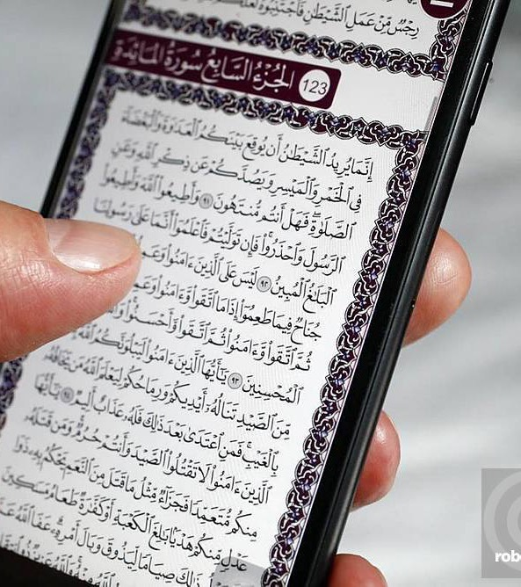
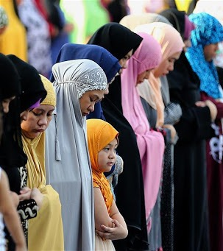
It is the Language of Islam
Some 1.9 billion Muslims worldwide read the Qur’an in Arabic and pray in Arabic.

Slide 6
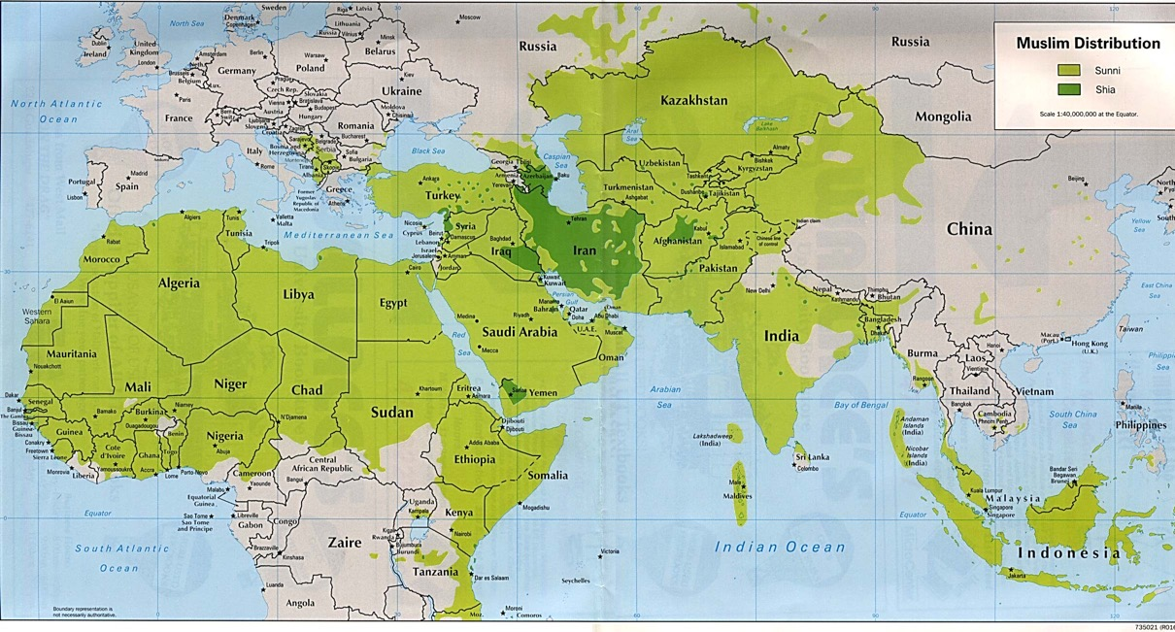
Areas with significant populations of Muslims

Slide 7
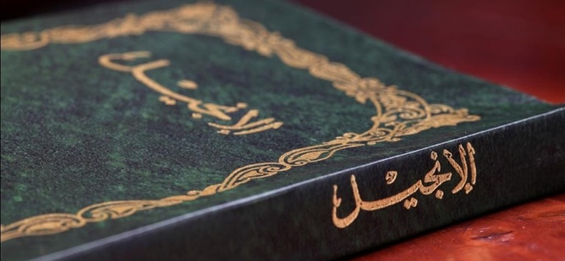
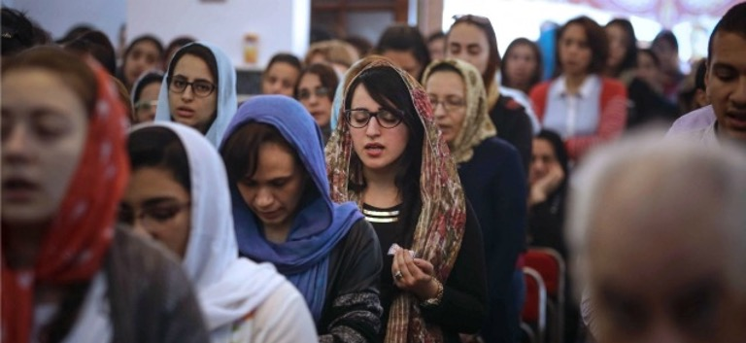
It is the Language of Arab Christians
Arabic is also the language of Scripture and prayer for some 30 million Christians in Africa and the Middle East.

Slide 8
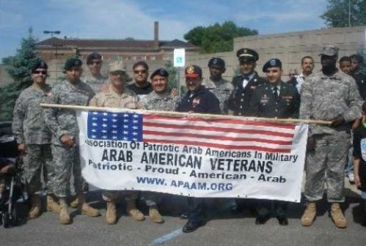
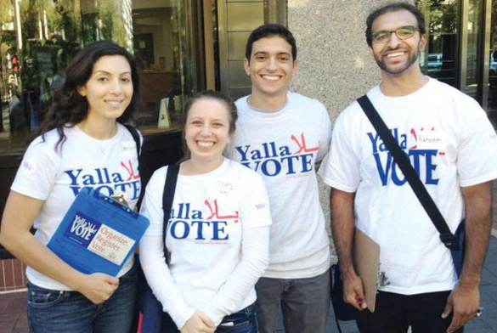
The Language of ONE MILLION Arab-Americans
One of the fastest growing languages in the US

Slide 9
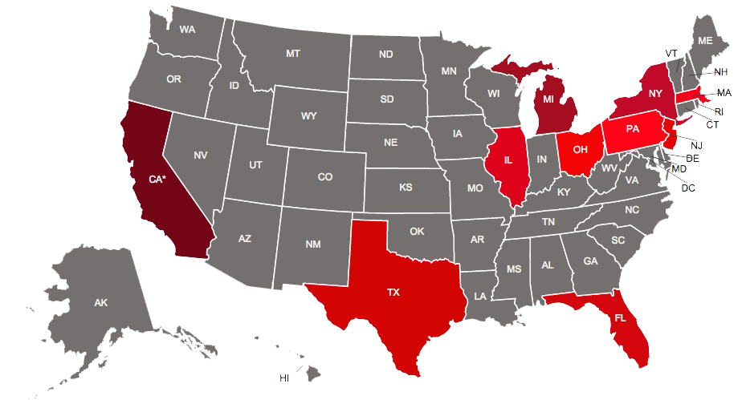
States with large populations of Arabic speakers
https://www.aaausa.org/arab-americans/where-do-arab-americans-live

Slide 10
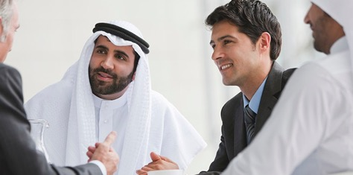
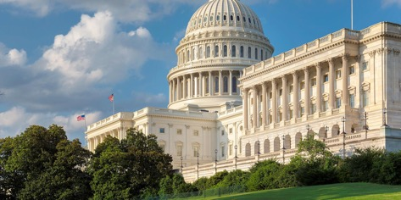
Distinguish yourself with Arabic!
Arabic will distinguish you from many other students.
Arabic can give you a huge advantage when seeking a job.
Arabic is a “critical need language.”

Slide 11
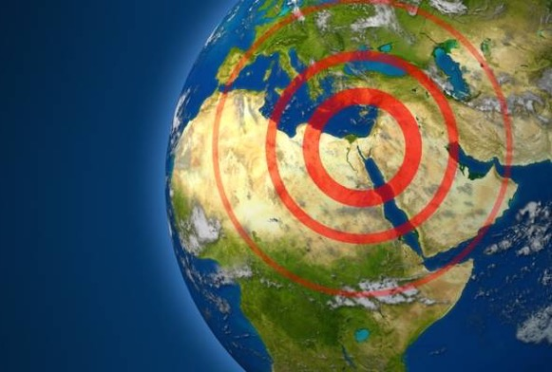
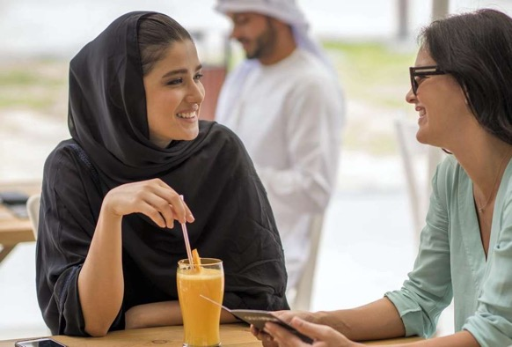
Widen your world with Arabic!
Arabic creates global citizens.
Provides diverse cultural perspectives.
Promotes understanding among peoples, nations, religions, etc.

Slide 12
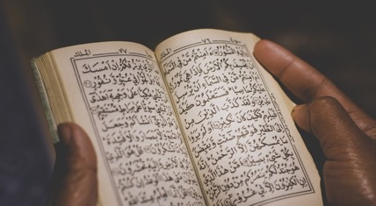
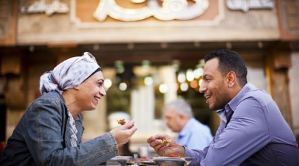
Three forms of Arabic
Classical Arabic
Qur’an, Bible, literature, academic works, etc. (8th – 19th Century CE)
Modern Standard Arabic (19th Century CE – present day)
Used for all print & electronic media
Formal speeches and exchanges, radio and television
Taught in school in Arab countries
Colloquial Arabic
Spoken Arabic used for everyday conversation (formal and casual)
The first form of Arabic that native speakers learn
Generally, it is not written.

Slide 13
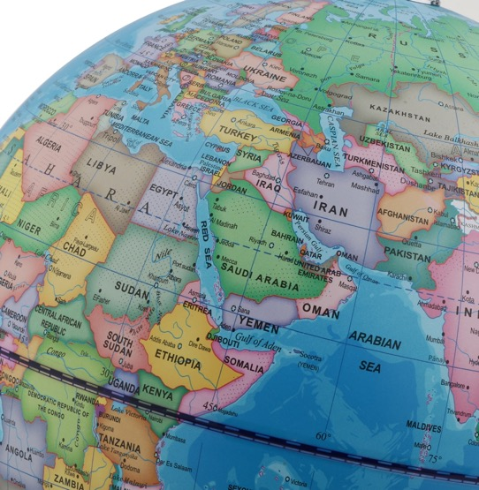
Colloquial Arabic
There are over 30 varieties of CA in 5 groups:
North African (Morocco-Libya)
Egyptian (Egypt & the Sudan)
Levantine (Pal., Leb., Syr. & Jordan)
Arabian (S.A. & the Gulf States)
Iraqi

Slide 14
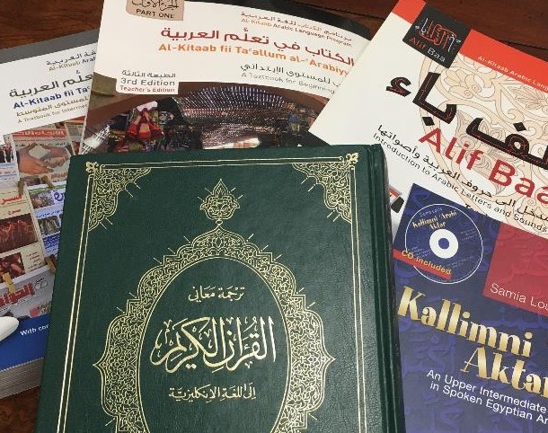
The Center for Arab & Islamic Studies provides instruction in all three varieties: MSA, Colloquial (Egyptian) & Classical!

Slide 15
Welcome!
Ahlan wa sahlan wa marhaban!

